Slide 1
OWNERS
JOAN QUIERRE
REGINE MACALLAN
ROBERT FERNANDEZ

Slide 2
LAO BUDDHIST SCULPTURE

Slide 3
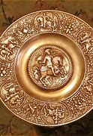
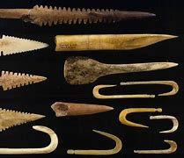
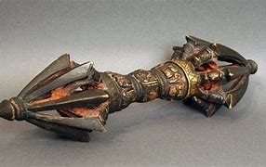
ARTIFACT
Buddhist Sculpture were created by the lao people of South East Asia.
They are typically made bronze, although gold and silver images can also be found.
The vat monorom is believed to the oldest sculpture gardens of Luang Pu Bunlea Sulilat provide a modern twist to the ancient tradition.

Slide 4

SOCIOFACT
Not only do the statues and images of buddha serve as physical representations or depictions on how buddha appeard in his physical form, but they also serve as symbols of Buddha's teaching,good fortune, inner peace, and the motivating force that should be present in every human being.

Slide 5

MENTIFACT
People believe that the Lao Buddhist Sculpture Theravada Buddhism is that dominant religion of the ethnic or "lowland" Lao, who constitute 53.2 percent of the overall population.
Theravada Buddhism, as a practised in Laos, borrows elements from animism(or spirit worship)of animism in Laos are ancestor worship and a belief that spirits inhabit all objects.

Slide 6

EDUCATIONAL IMPACT
For us Lao Buddhist Sculpture is big impact that we can show what we can do not only what you think of us and we can show it more clearly and understand that we can motivate ourselves to other people.

